Slide 1
Cloud Adoption Framework Strategy: Define Business and Expected Outcomes
Notes:
Presented by Tech Innovation Labs (TIL)
anthony.clendenen@gmail.com

Slide 2
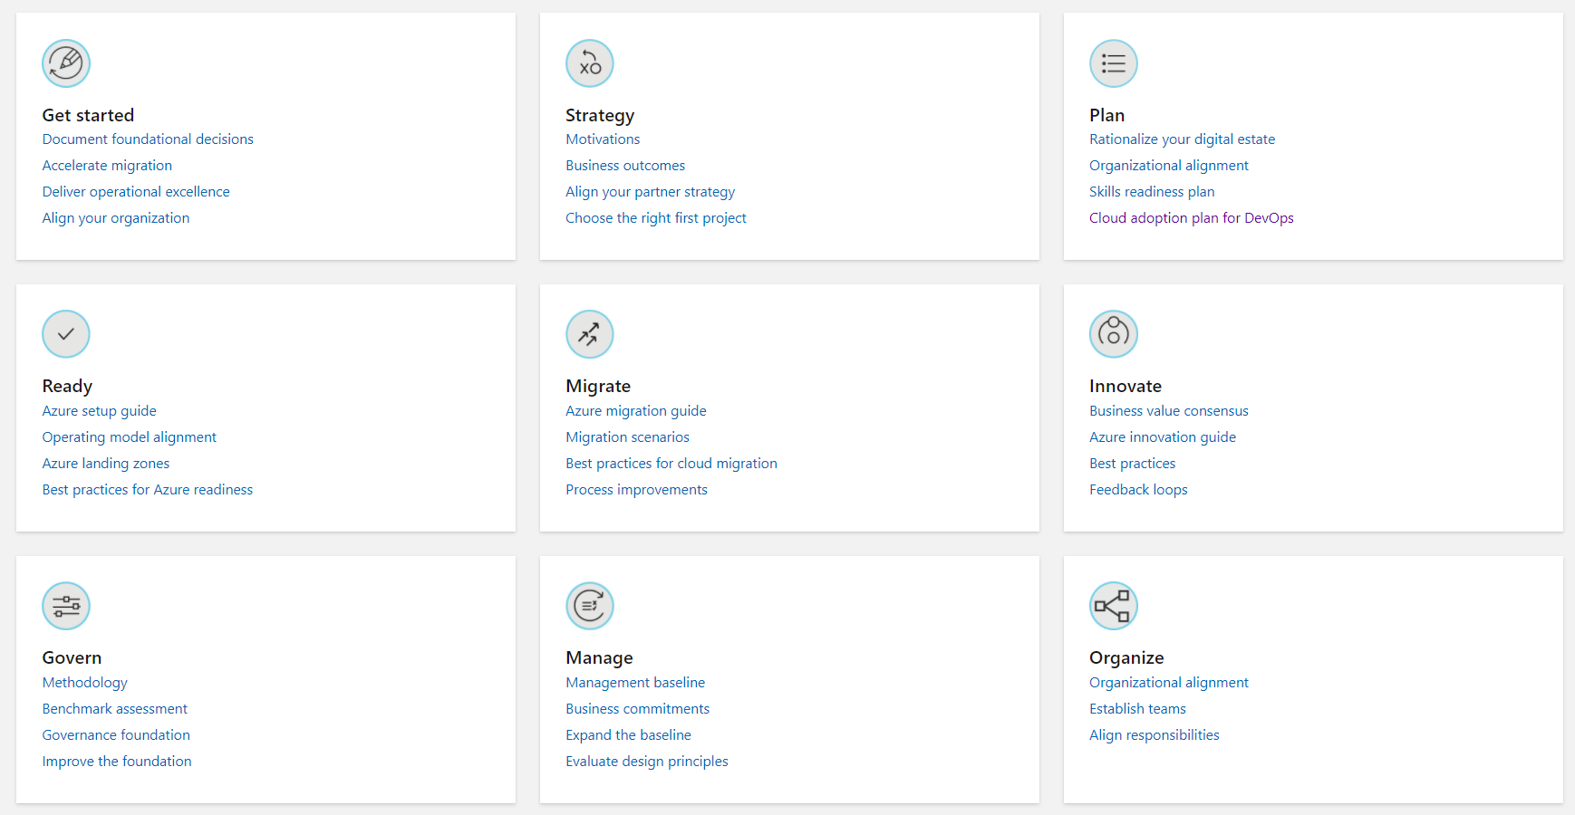

Slide 3
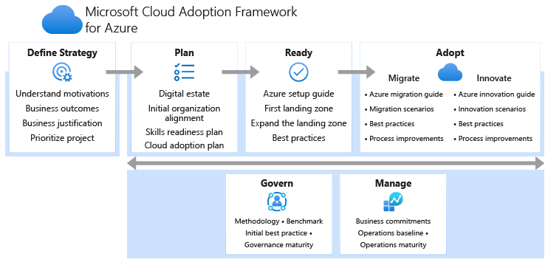

Slide 4

Executive Summary
Executive Summary
[Overview of your business priorities, timelines and milestones in the upcoming year for successful cloud adoption. Also include prioritized projects and criteria for such projects.]
Notes:
Complete the Microsoft Cloud Adoption Framework Strategy and Plan Template

Slide 5
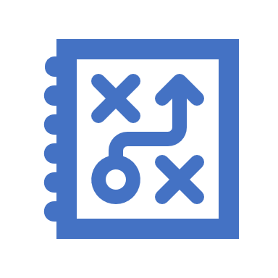
understanding motivations
Critical Business Event
When a response to critical business events is the highest priority, it's important to engage early in cloud implementation, often in parallel with strategy and planning efforts. Taking this approach requires a growth mindset and a willingness to iteratively improve processes, based on direct lessons learned.
Migration
When migration is the highest priority, strategy and planning will play a vital role early in the process. We recommend that you implement the first workload in parallel with planning, to help the team understand and anticipate any learning curves that are associated with cloud adoption.
Innovation
When innovation is the highest priority, strategy and planning will require additional investments early in the process to ensure balance in the portfolio and wise alignment of the investment made during cloud adoption.
Notes:
Your motivations for cloud adoption will likely fall into multiple categories. As you're building the list of motivations, trends will likely emerge. Motivations tend to be associated more with one classification than with others. Use the predominant classification to help guide the development of your cloud adoption strategy.

Slide 6
Understand Motivations
Critical Business Events | Migration | Innovation
Datacenter exit | Cost savings | Preparation for new technical capabilities
Merger, acquisition, or divestiture | Reduction in vendor or technical complexity | Building new technical capabilities
Reduction in capital expenses | Optimization of internal operations | Scaling to meet market demands
End of support for mission-critical technologies | Increase in business agility | Scaling to meet geographic demands
Response to regulatory compliance changes | Preparation for new technical capabilities | Improved customer experiences and engagements
New data sovereignty requirements | Scaling to meet market demands | Transformation of products or services
Reduction of disruptions and improvement of IT stability | Scaling to meet geographic demands | Market disruption with new products or services
Why are we moving to the cloud?
Why do you want to adopt the cloud?
Notes:
Complete the Microsoft Cloud Adoption Framework Strategy and Plan Template
(Examples in the table above)

Slide 7

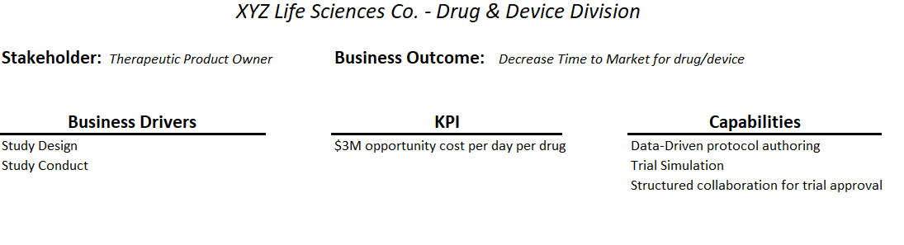
Business outcomes
The most successful transformation journeys start with a business outcome in mind.
Cloud adoption can be a costly and time-consuming effort. Fostering the right level of support from IT and other areas of the business is crucial to success.
Notes:
Complete the Business Outcomes Template, transfer output to the Microsoft Cloud Adoption Framework Strategy and Plan Template

Slide 8

Outcome examples
Fiscal outcomes:
Revenue: Will more money come into the business as a result of the sales of goods or services.
Cost: Will less money be spent in the creation, marketing, sales, or delivery of goods or services.
Profit: Although they're rare, some transformations can both increase revenue and decrease costs. This is a profit outcome.
Agility outcomes:
Time-to-market is a key measure of IT's ability to address market change.
Provisioning being able to scale in hours instead of weeks
Notes:
Complete the Business Outcomes Template, transfer output to the Microsoft Cloud Adoption Framework Strategy and Plan Template

Slide 9

Outcome examples
Global Reach Outcomes:
New Markets
Global access
Data sovereignty
Customer Engagement Outcomes:
Cycle times (DevOps)
Performance Outcomes
Reliability Outcomes
Notes:
Complete the Business Outcomes Template, transfer output to the Microsoft Cloud Adoption Framework Strategy and Plan Template

Slide 10

Business justifications
Dispelling Common Myths
Myth 1: The cloud is always cheaper. It's commonly believed that operating a datacenter in the cloud is always cheaper than operating one on-premises.
Myth 2: Everything should go into the cloud. In fact, some business drivers might lead you to choose a hybrid solution.
Myth 3: Mirroring my on-premises environment will help me save money in the cloud. During digital estate planning, it's not unheard of for businesses to detect unused capacity of more than 50% of the provisioned environment.
Myth 4: Server costs drive business cases for cloud migration. Sometimes this assumption is true. For some companies, it's important to reduce ongoing capital expenses related to servers.
Myth 5: An operating expense model is better than a capital expense model.
Myth 6: Moving to the cloud is like flipping a switch.
Notes:
Myth: The cloud is always cheaper. It's commonly believed that operating a datacenter in the cloud is always cheaper than operating one on-premises. While this assumption might generally be true, it's not always the case. Sometimes cloud operating costs are higher. These higher costs are often caused by poor cost governance, misaligned system architectures, process duplication, atypical system configurations, or greater staffing costs. Fortunately, you can mitigate many of these problems to create early ROI. Following the guidance in Build the business justification can help you detect and avoid these misalignments. Dispelling the other myths described here can help too.
Myth: Everything should go into the cloud. In fact, some business drivers might lead you to choose a hybrid solution. Before you finalize a business model, it's smart to complete a first-round quantitative analysis, as described in the digital estate articles. For more information on the individual quantitative drivers involved in rationalization, see The 5 Rs of rationalization. Either approach will use easily obtained inventory data and a brief quantitative analysis to identify workloads or applications that could result in higher costs in the cloud. These approaches could also identify dependencies or traffic patterns that would necessitate a hybrid solution.
Myth: Mirroring my on-premises environment will help me save money in the cloud. During digital estate planning, it's not unheard of for businesses to detect unused capacity of more than 50% of the provisioned environment. If assets are provisioned in the cloud to match current provisioning, cost savings are hard to realize. Consider reducing the size of the deployed assets to align with usage patterns rather than provisioning patterns.
Myth: Server costs drive business cases for cloud migration. Sometimes this assumption is true. For some companies, it's important to reduce ongoing capital expenses related to servers. But it depends on several factors. Companies with a five-year to eight-year hardware refresh cycle are unlikely to see fast returns on their cloud migration. Companies with standardized or enforced refresh cycles can hit a break-even point quickly. In either case, other expenses might be the financial triggers that justify the migration. Here are a few examples of costs that are commonly overlooked when companies take a server-only or VM-only view of costs:
Costs of software for virtualization, servers, and middleware can be extensive. Cloud providers eliminate some of these costs. Two examples of a cloud provider reducing virtualization costs are the Azure Hybrid Benefit and Azure reservations programs.
Business losses caused by outages can quickly exceed hardware or software costs. If your current datacenter is unstable, work with the business to quantify the impact of outages in terms of opportunity costs or actual business costs.
Environmental costs can also be significant. For the average American family, a home is the biggest investment and the highest cost in the budget. The same is often true for datacenters. Real estate, facilities, and utility costs represent a fair portion of on-premises costs. When datacenters are retired, those facilities can be repurposed, or your business could potentially be released from these costs entirely.
Myth: An operating expense model is better than a capital expense model. As explained in the fiscal outcomes article, an operating expense model can be a good thing. But some industries view operating expenditures negatively. Here are a few examples that would trigger tighter integration with the accounting and business units regarding the operating expense conversation:
When a business sees capital assets as a driver for business valuation, capital expense reductions could be a negative outcome. Though it's not a universal standard, this sentiment is most commonly seen in the retail, manufacturing, and construction industries.
A private equity firm or a company that's seeking capital influx might consider operating expense increases as a negative outcome.
If a business focuses heavily on improving sales margins or reducing cost of goods sold (COGS), operating expenses could be a negative outcome.
Businesses are more likely to see operating expense as more favorable than capital expense. For example, this approach might be well received by businesses that are trying to improve cash flow, reduce capital investments, or decrease asset holdings.
Before you provide a business justification that focuses on a conversion from capital expense to operating expense, understand which is better for your business. Accounting and procurement can often help align the message to financial objectives.
Myth: Moving to the cloud is like flipping a switch. Migrations are a manually intense technical transformation. When developing a business justification, especially justifications that are time sensitive, consider the following aspects that could increase the time it takes to migrate assets:
Bandwidth limitations: The amount of bandwidth between the current datacenter and the cloud provider will drive timelines during migration.
Testing timelines: Testing applications with the business to ensure readiness and performance can be time consuming. Aligning power users and testing processes is critical.
Migration timelines: The amount of time and effort required to implement the migration can increase costs and cause delays. Allocating employees or contracting partners can also delay the process. The plan should account for these allocations.
Technical and cultural impediments can slow cloud adoption. When time is an important aspect of the business justification, the best mitigation is proper planning. During planning, two approaches can help mitigate timeline risks:
Invest the time and energy in understanding technical adoption constraints. Though pressure to move quickly might be high, it's important to account for realistic timelines.
If cultural or people impediments arise, they'll have more serious effects than technical constraints. Cloud adoption creates change, which produces the desired transformation. Unfortunately, people sometimes fear change and might need additional support to align with the plan. Identify key people on the team who are opposed to change and engage them early.
To maximize readiness and mitigation of timeline risks, prepare executive stakeholders by firmly aligning business value and business outcomes. Help those stakeholders understand the changes that will come with the transformation. Be clear and set realistic expectations from the beginning. When people or technologies slow the process, it will be easier to enlist executive support.

Slide 11
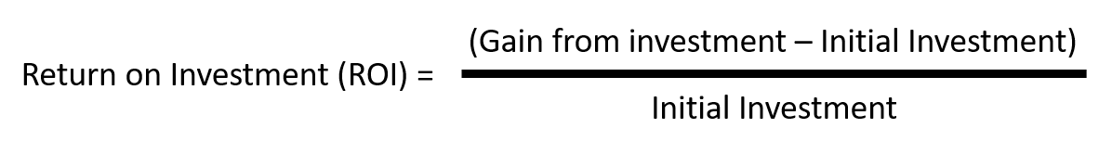
Building business justification
At the highest level, the formula for business justification is simple. But the subtle data points required to populate the formula can be difficult to align. On a basic level, the business justification focuses on the return on investment (ROI) associated with the proposed technical change.
The generic formula for ROI is:
Notes:
Return on investment (ROI) is often an important criteria for the C-suite or the board. ROI is used to compare different ways to invest limited capital resources. The formula for ROI is fairly simple. The details you'll need to create each input to the formula might not be as simple. Essentially, ROI is the amount of return produced from an initial investment. It's usually represented as a percentage:

Slide 12

Building Financial Model - Calculate the initial investment
Sum of these is initial investment
Capital expense
Operating expense
Examples – Only during the transformation
Software licenses
Cost of cloud services
Professional services
Salaried employees
Notes:
Initial investment is the capital expense and operating expense required to complete a transformation. The classification of costs can vary depending on accounting models and CFO preference. But this category would include items like professional services to transform, software licenses used only during the transformation, the cost of cloud services during the transformation, and potentially the cost of salaried employees during the transformation.
Add these costs to create an estimate of the initial investment.

Slide 13

Building financial model - Gains from initial investment
Calculating the gain from investment often requires a second formula that's specific to the business outcomes and associated technical changes. Calculating earnings is harder than calculating cost reductions.
To calculate earnings, you need two variables:

Slide 14

Revenue deltas
Revenue deltas should be forecast in partnership with business stakeholders. After the business stakeholders agree on a revenue impact, it can be used to improve the earning position.
Notes:
Revenue deltas should be forecast in partnership with business stakeholders. After the business stakeholders agree on a revenue impact, it can be used to improve the earning position.

Slide 15

Cost deltas
Cost deltas are the amount of increase or decrease that will be caused by the transformation.
Independent variables can affect cost deltas. Earnings are largely based on hard costs like capital expense reductions, cost avoidance, operational cost reductions, and depreciation reductions.

Slide 16
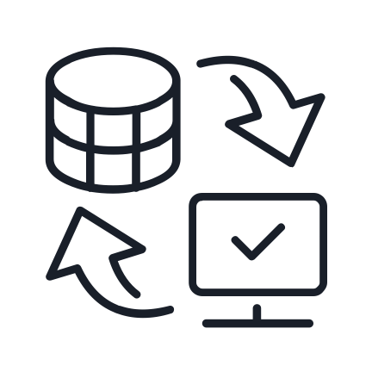
Cost deltas - Examples
Depreciation reduction or acceleration
When capital is invested in the acquisition of an asset, that investment could be used for financial or tax purposes to produce ongoing benefits over the expected lifespan of the asset.
Physical asset recovery
In some cases, retired assets can be sold as a source of revenue. This revenue is often lumped into cost reduction for simplicity. But it's truly an increase in revenue and can be taxed as such
Notes:
Depreciation reduction or acceleration
For guidance on depreciation, speak with the CFO or finance team. The following information is meant to serve as a general reference on the topic of depreciation.
When capital is invested in the acquisition of an asset, that investment could be used for financial or tax purposes to produce ongoing benefits over the expected lifespan of the asset. Some companies see depreciation as a positive tax advantage. Others see it as a committed, ongoing expense similar to other recurring expenses attributed to the annual IT budget.
Speak with the finance office to find out if elimination of depreciation is possible and if it would make a positive contribution to cost deltas.
Physical asset recovery
In some cases, retired assets can be sold as a source of revenue. This revenue is often lumped into cost reduction for simplicity. But it's truly an increase in revenue and can be taxed as such. Speak with the finance office to understand the viability of this option and how to account for the resulting revenue.

Slide 17
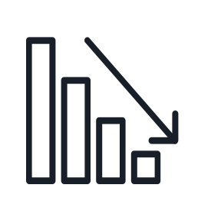
Cost deltas - Examples
Operational Cost Reductions
Recurring expenses required to operate a business are often called operating expenses. This is a broad category. In most accounting models, it includes:
Software licensing
Hosting expenses
Electric bills, Cooling expenses, Real estate rentals, Equipment rentals
Temporary staff required for operations.
Maintenance contracts, Repair services, Replacement parts
Business continuity and disaster recovery (BCDR) services.
Other expenses that don't require capital expense approvals.
This category provides one of the highest earning deltas. When you're considering a cloud migration, time invested in making this list exhaustive is rarely wasted.
Notes:
Operational cost reductions
Recurring expenses required to operate a business are often called operating expenses. This is a broad category. In most accounting models, it includes:
Software licensing.
Hosting expenses.
Electric bills.
Real estate rentals.
Cooling expenses.
Temporary staff required for operations.
Equipment rentals.
Replacement parts.
Maintenance contracts.
Repair services.
Business continuity and disaster recovery (BCDR) services.
Other expenses that don't require capital expense approvals.
This category provides one of the highest earning deltas. When you're considering a cloud migration, time invested in making this list exhaustive is rarely wasted. Ask the CIO and finance team questions to ensure all operational costs are accounted for.

Slide 18
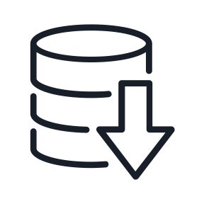
Cost deltas - Examples
Cost avoidance
When an operating expenditure is expected but not yet in an approved budget, it might not fit into a cost reduction category. For example, if VMware and Microsoft licenses need to be renegotiated and paid next year, they aren't fully qualified costs yet. Reductions in those expected costs are treated like operational costs for the sake of cost-delta calculations. Informally, however, they should be referred to as "cost avoidance" until negotiation and budget approval is complete.
Soft-cost reductions
At some companies, soft costs like reductions in operational complexity or reductions in full-time staff for operating a datacenter could also be included in cost deltas. But including soft costs might not be a good idea. When you include soft-cost reductions, you insert an undocumented assumption that the reduction will create tangible cost savings. Technology projects rarely result in actual soft-cost recovery.
Notes:
Cost avoidance
When an operating expenditure is expected but not yet in an approved budget, it might not fit into a cost reduction category. For example, if VMware and Microsoft licenses need to be renegotiated and paid next year, they aren't fully qualified costs yet. Reductions in those expected costs are treated like operational costs for the sake of cost-delta calculations. Informally, however, they should be referred to as "cost avoidance" until negotiation and budget approval is complete.
Soft-cost reductions
At some companies, soft costs like reductions in operational complexity or reductions in full-time staff for operating a datacenter could also be included in cost deltas. But including soft costs might not be a good idea. When you include soft-cost reductions, you insert an undocumented assumption that the reduction will create tangible cost savings. Technology projects rarely result in actual soft-cost recovery.

Slide 19

Cost deltas - Examples
Capital expense reductions or avoidance
Capital expenses are slightly different from operating expenses. Generally, this category is driven by refresh cycles or datacenter expansion. When a refresh cycle hits, IT draws capital expense to acquire new equipment.
If a refresh cycle is approved and budgeted, the cloud transformation could help eliminate that cost. If a refresh cycle is planned but not yet approved, the cloud transformation could avoid a capital expenditure. Both reductions would be added to the cost delta.
Notes:
Capital expense reductions or avoidance
Capital expenses are slightly different from operating expenses. Generally, this category is driven by refresh cycles or datacenter expansion. An example of a datacenter expansion would be a new high-performance cluster to host a big data solution or data warehouse. This expense would generally fit into a capital expense category. More common are the basic refresh cycles. Some companies have rigid hardware refresh cycles, meaning assets are retired and replaced on a regular cycle (usually every three, five, or eight years). These cycles often coincide with asset lease cycles or the forecasted life span of equipment. When a refresh cycle hits, IT draws capital expense to acquire new equipment.
If a refresh cycle is approved and budgeted, the cloud transformation could help eliminate that cost. If a refresh cycle is planned but not yet approved, the cloud transformation could avoid a capital expenditure. Both reductions would be added to the cost delta.

Slide 20

Cloud accounting models
Traditional IT accounting (cost center model)
Central IT accounting (profit center model)
Chargeback
Showback or awareness-back (shameback)
The choice of accounting models is crucial in system design. The choice of accounting model can affect subscription strategies, naming standards, tagging standards, and policy and blueprint designs.
Notes:
Traditional IT accounting (cost center model)
It's often accurate to consider IT a cost center. In the traditional IT accounting model, IT consolidates purchasing power for all IT assets. As we pointed out in the financial models article, that purchasing power consolidation can include software licenses, recurring charges for CRM licensing, purchase of employee desktops, and other large costs.
When IT serves as a cost center, the perceived value of IT is largely viewed through a procurement management lens. This perception makes it difficult for the board or other executives to understand the true value that IT provides. Procurement costs tend to skew the view of IT by outweighing any other value added by the organization. This view explains why IT is often lumped into the responsibilities of either the chief financial officer or the chief operating officer. This perception of IT is limited and can be short sighted.
Central IT accounting (profit center model)
To overcome the cost center view of IT, some CIOs opted for a central IT model of accounting. In this type of model, IT is treated like a competing business unit and a peer to revenue-producing business units. In some cases, this model can be entirely logical. For example, some organizations have a professional IT services division that generates a revenue stream. Frequently, central IT models don't generate significant revenue, making it difficult to justify the model.
Regardless of the revenue model, central IT accounting models are unique because of how the IT unit accounts for costs. In a traditional IT model, the IT team records costs and pays those costs from shared funds like operations and maintenance (O&M) or a dedicated profit and loss (P&L) account.
In a central IT accounting model, the IT team marks up the services provided to account for overhead, management, and other estimated expenses. It then bills the competing business units for the marked-up services. In this model, the CIO is expected to manage the P&L associated with the sale of those services. This can create inflated IT costs and contention between central IT and business units, especially when IT needs to cut costs or isn't meeting agreed-upon SLAs. During times of technology or market change, any new technology would cause a disruption to central IT's P&L, making transformation difficult.
Chargeback
One of the common first steps in changing IT's reputation as a cost center is implementing a chargeback model of accounting. This model is especially common in smaller enterprises or highly efficient IT organizations. In the chargeback model, any IT costs that are associated with a specific business unit are treated like an operating expense in that business unit's budget. This practice reduces the cumulative cost effects on IT, allowing business values to show more clearly.
In a legacy on-premises model, chargeback is difficult to realize because someone still has to carry the large capital expenses and depreciation. The ongoing conversion from capital expenditures to operating expenses associated with usage is a difficult accounting exercise. This difficulty is a major reason for the creation of the traditional IT accounting model and the central IT accounting model. The operating expenses model of cloud cost accounting is almost required if you want to efficiently deliver a chargeback model.
But you shouldn't implement this model without considering the implications. Here are a few consequences that are unique to a chargeback model:
Chargeback results in a massive reduction of the overall IT budget. For IT organizations that are inefficient or require extensive complex technical skills in operations or maintenance, this model can expose those expenses in an unhealthy way.
Loss of control is a common consequence. In highly political environments, chargeback can result in loss of control and staff being reallocated to the business. This could create significant inefficiencies and reduce IT's ability to consistently meet SLAs or project requirements.
Difficulty accounting for shared services is another common consequence. If the organization has grown through acquisition and is carrying technical debt as a result, it's likely that a high percentage of shared services must be maintained to keep all systems working together effectively.
Cloud transformations include solutions to these and other consequences associated with a chargeback model. But each of those solutions includes implementation and operating expenses. The CIO and CFO should carefully weigh the pros and cons of a chargeback model before considering one.
Showback or awareness-back (shameback)
For larger enterprises, a showback or awareness-back model is a safer first step in the transition from cost center to value center. This model doesn't affect financial accounting. In fact, the P&Ls of each organization don't change. The biggest shift is in mindset and awareness. In a showback or awareness-back model, IT manages the centralized, consolidated buying power as an agent for the business. In reports back to the business, IT attributes any direct costs to the relevant business unit, which reduces the perceived budget directly consumed by IT. IT also plans budgets based on the needs of the associated business units, which allows IT to more accurately account for costs associated to purely IT initiatives.
This model provides a balance between a true chargeback model and more traditional models of IT accounting.

Slide 21

First cloud adoption project
Starting a first adoption process in parallel with the development of the plan provides some benefits:
Establish a growth mindset to encourage learning and exploration
Provide an opportunity for the team to develop necessary skills
Create situations that encourage new approaches to collaboration
Identify skill gaps and potential partnership needs
Provide tangible inputs to the plan
Notes:
https://docs.microsoft.com/en-us/azure/cloud-adoption-framework/strategy/first-adoption-project

Slide 22
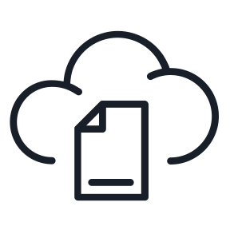
First cloud adoption project
First project criteria
Your first adoption project should align with your motivations for cloud adoption. Whenever possible, your first project should also demonstrate progress toward a defined business outcome.
First project expectations
Your team's first adoption project is likely to result in a production deployment of some kind. But this isn't always the case. Establish proper expectations early. Here are a few wise expectations to set:
This project is a source of learning.
This project might result in production deployments, but it will probably require additional effort first.
The output of this project is a set of clear requirements to provide a longer-term production solution.

Slide 23
FIRST CLOUD ADOPTION PROJECT
To support the preceding criteria, this list provides an example of a first project for each motivation category:
Critical business events
Migration motivations: When migration is the primary motivation, it's wise to start with the migration of a noncritical workload.
Innovation motivations: When innovation is the primary motivation, creation of a targeted dev/test environment can be a great first project.
Notes:
Additional examples of first adoption projects include:
Business continuity and disaster recovery (BCDR): Beyond Azure Site Recovery, you can implement multiple BCDR strategies as a first project.
Nonproduction: Deploy a nonproduction instance of a workload.
Archive: Cold storage can place a strain on datacenter resources. Moving that data to the cloud is a solid quick win.
End of support (EOS): Migrating assets that have reached the end of support is another quick win that builds technical skills. It could also provide some cost avoidance from expensive support contracts or licensing costs.
Virtual Desktop Interface (VDI): Creating virtual desktops for remote employees can provide a quick win. In some cases, this first adoption project could also reduce dependence on expensive private networks in favor of commodity public internet connectivity.
Dev/test: Remove dev/test from on-premises environments to give developers control, agility, and self-service capacity.
Simple apps (less than five): Modernize and migrate a simple app to quickly gain developer and operations experience.
Performance labs: When you need high-scale performance in a lab setting, use the cloud to quickly and cost-effectively provision those labs for a short time.
Data Platform: Creating a data lake with scalable compute for analytics, reporting, or machine learning workloads, and migrating to managed databases using dump/restore methods or data migration services.

Slide 24
Q & A

Slide 25
How would you measure success?
Beyond achieving the business outcomes, are there other indicators for successful cloud adoption in your organization?

